Slide 1
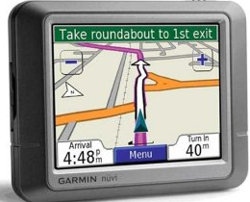
GPS-Based Road congestion detection
Ashwin Revo, Fei Xiang, Osman Sayli

Slide 2
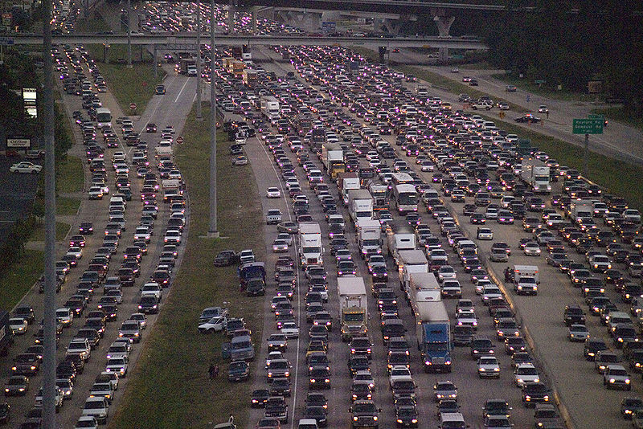
Congestion...

Slide 3
Problem Statement
The aim of the project is to detect road congestion conditions using location information of vehicles on the road
The location of vehicles is obtained from the GPS devices on user mobile phones
The road congestion will be characterized as high, moderate and null

Slide 4
Congestion detection problem
Location information of vehicles continuously relayed by GPS enabled cell phones
Speed of vehicles estimated using location information at multiple sampling instants
Using estimated speeds, traffic congestion detected
H₀ – No congestion
H₁ – Moderate congestion
H₂ – High congestion
H₀ | Speed > γ₂
H₁ | γ₁ <Speed < γ₂
H₂ | Speed < γ₁

Slide 5
GPS Error
Triangulation depends on:
(1) Satellite position (ephemeris error)
(2) Satellite clock (clock error)
(3) Time delay (time at which signal is received on Earth)
Other sources of error are Atmospheric error, Numerical error, Multipath etc.

Slide 6
GPS Error
There is an error at every stage.
GPS Location fix:
Commercial GPS receivers can give a fix with an accuracy of ± 15m (typically accuracy)
PDOP – Position Dilution of Precision

Slide 7
Algorithm Overview
Step 1: Position estimation
Step 2: Speed estimation
Step 3: Do speed estimation for multiple cars and multiple intervals within a certain block of road. Get a vector of speeds of different cars during different intervals.
Assumption: vector of speeds corresponding to 1mile belong to same hypothesis

Slide 8
Algorithm Overview
Step 4: Create three hypothesis representing different levels of congestion. (This depends on which road the speed data are coming from.)
Step 5: Use Neyman-Pearson Test to find the thresholds.
Step 6: Use the LRT to detect which hypothesis is true.

Slide 9
Estimation of Speed
(P₁ and P₂ are the actual positions of car)
Estimator is unbiased and efficient.
is some non-random value.

Slide 10
Estimation of Speed
For vehicle i, the estimations of speed in different time intervals are:
Combine all the speed estimations for each vehicle into a single vector:
The vector above will be used to detect the congestion status of the road.

Slide 11
Detection of Road Congestion
Congestion Modeling
Assumption: Under each hypothesis, speeds of vehicles on the road have Gaussian Distribution(3)(4).
H₂ : High Congestion ~
H₁ : Medium Congestion ~
H₀ : No Congestion ~

Slide 12
Detection of Road Congestion
Likelihood Ratio Test:
Thresholds η_{ij} are unknown. Need to determine the thresholds using Neyman-Pearson test.

Slide 13
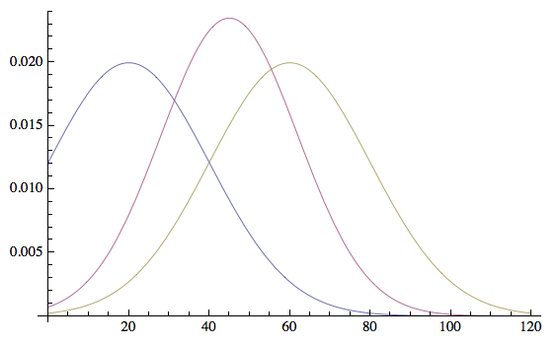
Detection of Road Congestion
H₁
H₂
H₀
η₂₁
η₁₀

Slide 14
Detection of Road Congestion
Neyman-Pearson Test:
For hypothesis H₀ ,
Given P_{F} , we can solve for η₁₀

Slide 15
Detection of Road Congestion
Neyman-Pearson Test:
For hypothesis H₁ ,
Given P_{F} , we can solve for η₂₁

Slide 16
Detection of Road Congestion
Now we have η₁₀ and η₂₁ , we can do the detection using the LRT below:

Slide 17
Analytical ROC
σ₁ – standard deviation of H1
σ₂ – standard deviation of H2
µ₁ – mean of H1
µ₂ – mean of H2
n – number of samples

Slide 18
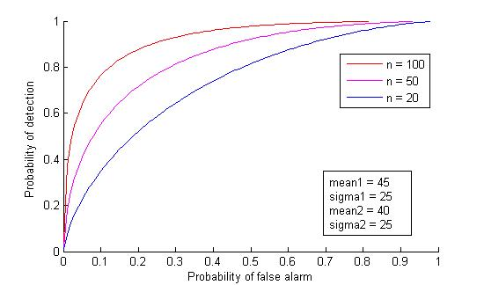
Analytical ROC

Slide 19
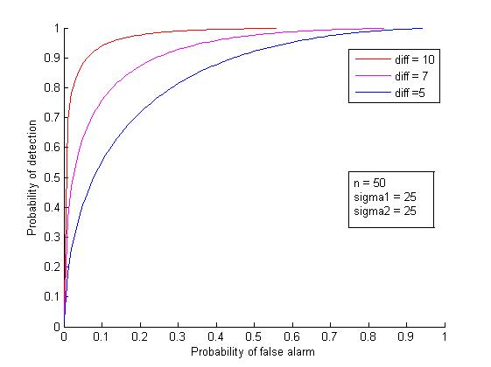
Analytical ROC

Slide 20
Estimator Performance
For an unbiased estimator,
mse(Â) = var(Â) =
mse reduces as ∆T increases
As ∆T increases, speed estimate does not match instantaneous vehicle speeds
Number of speed samples available for traffic detection reduces

Slide 21
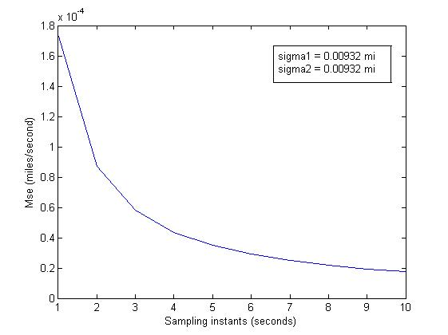
Sampling Rate

Slide 22
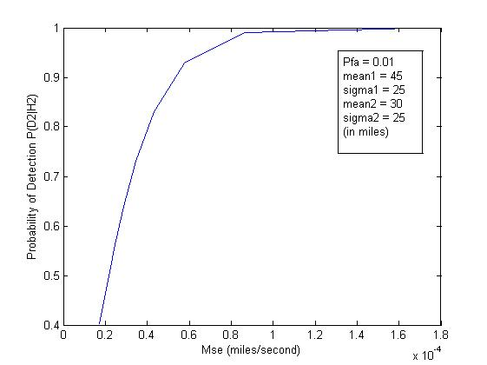
Sampling Rate
Sampling instant of 2 seconds optimum

Slide 23
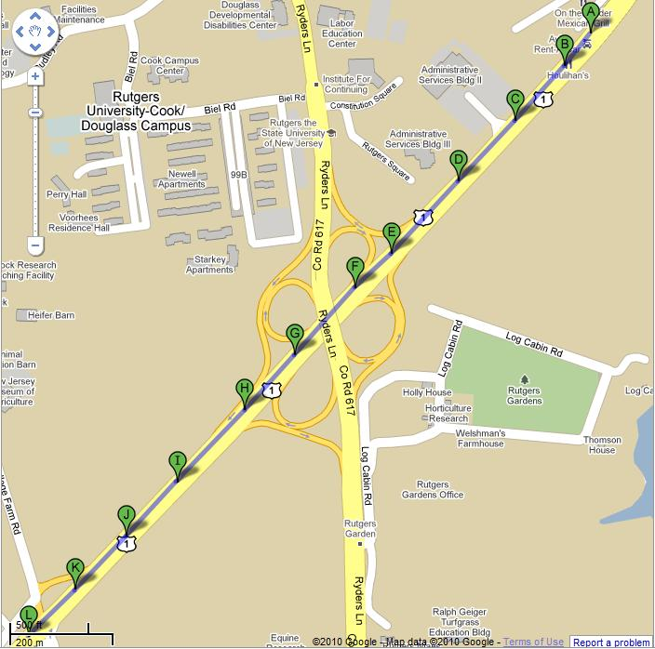
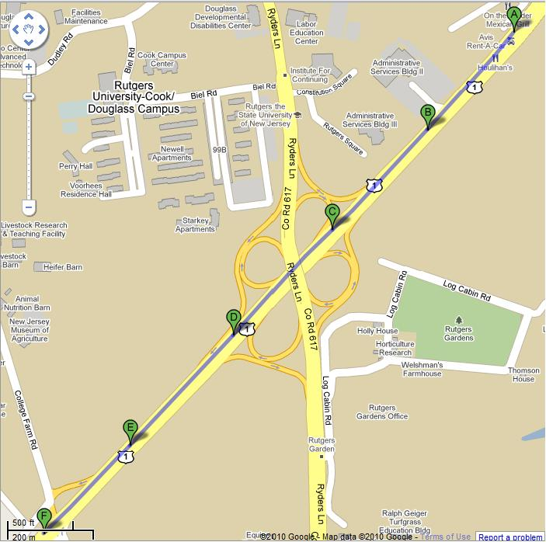
Simulation – US1 South
Car traveling with speed = 18 mph
Congestion - High
Car traveling with speed = 72 mph
Congestion - Null

Slide 24
Conclusion
Developed an algorithm for road traffic detection
Based on speed estimation from GPS coordinates of on road vehicles
Calculation of system parameters studied
Algorithm results verified using simulations

Slide 25
References
Mobile Millennium Project, http://traffic.berkeley.edu/index.html
http://en.wikipedia.org/wiki/Global_Positioning_System
Joonho Ko, Randall L. Guensler, ‘Characterization of Congestion Based on Speed Distribution: A Statistical Approach Using Gaussian Mixture Model’
Kloeden CN, Ponte G, McLean AJ, ‘Travelling Speed and the Risk of Crash Involvement on Rural Roads’

